Slide 1
Network Security- IPSec
By,
M.K.Chavan

Slide 2
Introduction
Internet was tiny and relatively private. Today it is enormous and truly public.
A number of methods have evolved over the years to address the need for security. Most of them are focused on the higher layers of the OSI model.
For example, SSL ( secure sockets layer) can be used for certain applications like world wide web or file transfer protocol (FTP).
IPSec is not a single protocol. It is a set of services and protocols that provide a complete security solution for an IP network.

Slide 3
IPSec
IP services and functions
Encryption of user data and privacy.
Authentication of the integrity of a message to ensure that is not changed.
Protection against certain types of security attacks such as replay attacks.
Ability for devices to negotiate the security algorithm and the required keys.

Slide 4
IPSec
IPSec operation
When two devices (user hosts, or intermediate devices such as routers and firewalls) want to engage in a secure communication, they set up a secure path between themselves that may traverse across many insecure intermediate systems.
Devices must agree on a set of security protocols such that each one sends data in a format that the other can understand.
Devices must decide on an encryption algorithm.
Devices must exchange keys.
IPSec provide confidentiality and authentication to the IP layer.

Slide 5
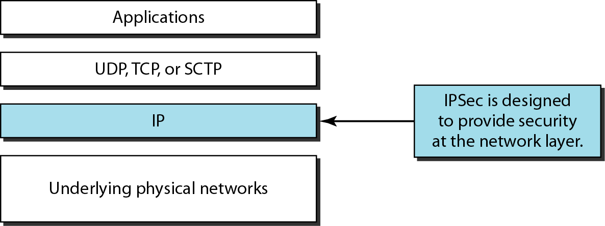
TCP/IP protocol suite and IPSec

Slide 6
IPsec
IPSec core protocols:
A number of different components make up the total package known as IPSec.
1- IPSec authentification header (AH): allows to verify that the intermediate devices have not changed any of the data in the datagram.
2- Encapsulated security payload (ESP): AH ensures the integrity of the data in a datagram, but not its privacy. ESP allows encryption to ensure privacy of a message.

Slide 7
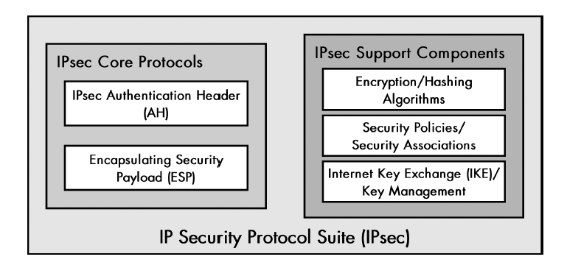
IPSec

Slide 8
IPSec
IPSec architecture:
1.Host-host implementation:
Putting all IPSec into all hosts devices.
Enables end to end security between any two devices on the network.
2- Router implementation:
Is much less work. You make changes to only a few routers instead of hundreds of clients. It provides protection only between pairs of routers.

Slide 9
IPSec Modes
1- Transport mode:
IPSec protects the message passed down to IP from the transport layer. The message is processed by AH and /or ESP and the appropriate headers are added.
IPSec in the transport mode does not protect the IP header; it only protects the information coming from the transport layer.
The transport mode is normally used when we need host-to-host protection of data.

Slide 10
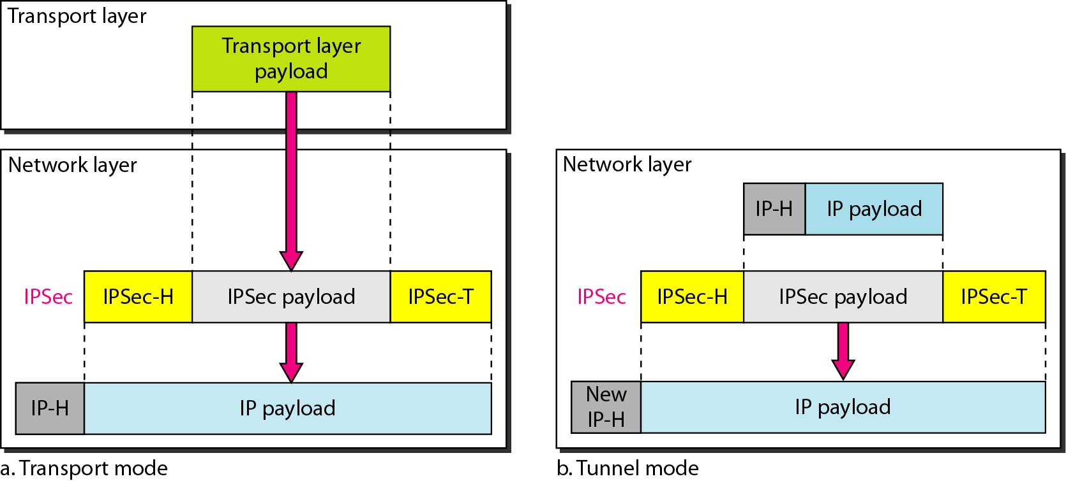
IPSec

Slide 11
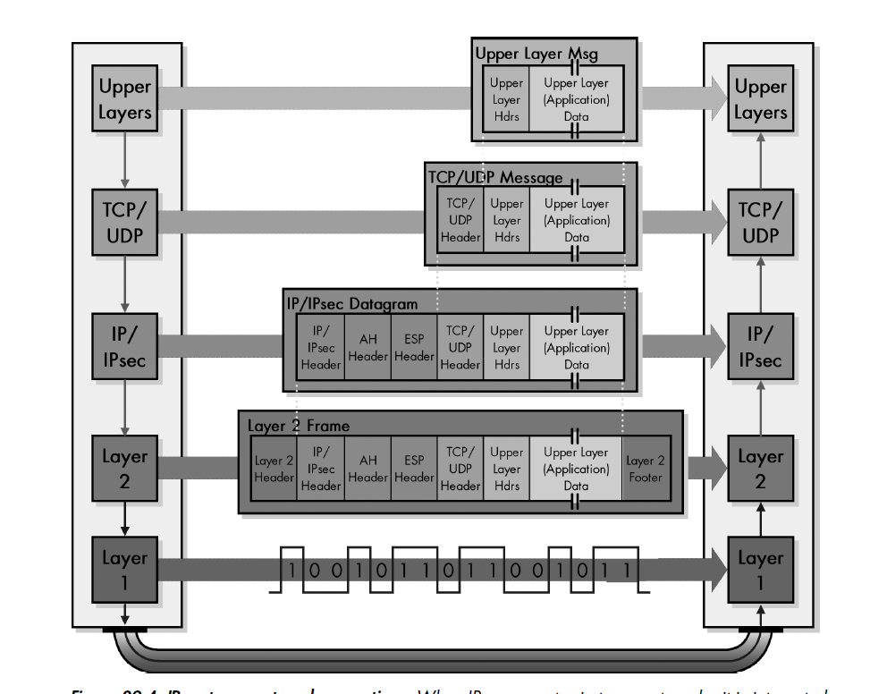
Transport Mode

Slide 12
Tunnel Mode
2- Tunnel mode:
IPSec is used to protect a completely encapsulated IP datagram after the IP header has already been applied to it.
IPSec in tunnel mode protects the original IP header.
It takes an IP packet, including the header, applies IPSec security methods to the entire packet, and then adds a new IP header.
It is used when either the sender or the receiver is not a host.

Slide 13
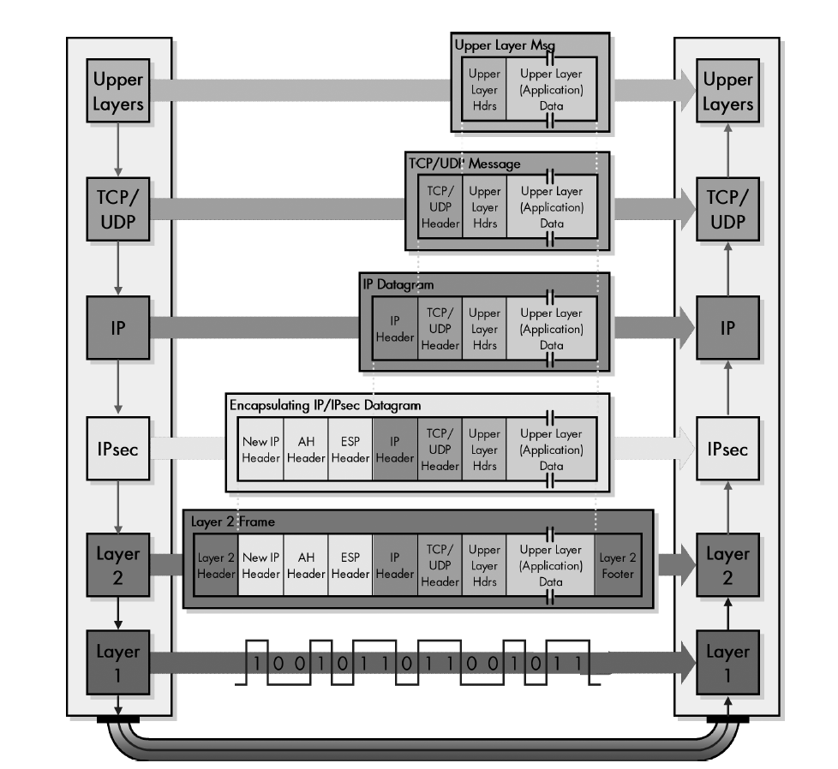
Tunnel Mode

Slide 14
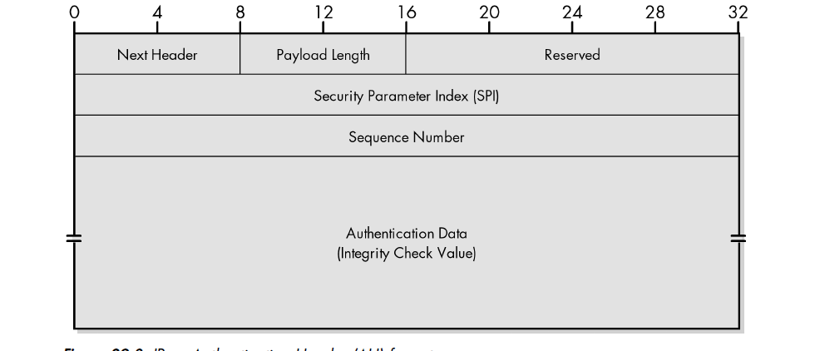
IPSec Authentication Header (AH)

Slide 15
IPSec Authentication Header (AH)
Next header: the 8-bit next-header field defines the type of payload carried by the IP datagram (such as TCP, UDP, ICMP,..).
Payload length: it defines the length of the authentication header
Security Parameter index: the 32-bit security parameter index (SPI) is same for all packets sent during a connection called a security association.
Sequence number: the 32-bit sequence number provides ordering information for a sequence of datagram.

Slide 16
Authentication Header (AH) Protocol in transport mode
Authentication data: Authentication data field is the result of applying a hash function to the entire IP datagram except for the field that are changed during transit e.g. time-to-live.

Slide 17
Encapsulating Security Payload (ESP) Protocol
Since AH does not provide privacy, IPSec later define an alternative protocol that provides source authentication, integrity, and privacy called Encapsulating Security Payload (ESP) Protocol.
ESP adds a header and trailer.

Slide 18
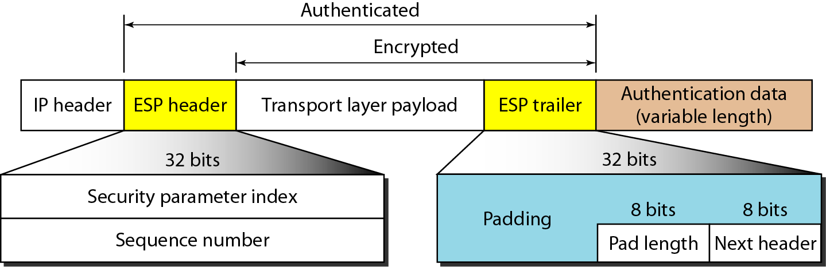
Encapsulating Security Payload (ESP)

Slide 19
Encapsulating Security Payload (ESP) Protocol in transport mode
Security parameter index: the 32-bit security parameter index field is similar to that defined for the AH protocol.
Sequence number: the 32-bit sequence number field is similar to that defined for the AH protocol.
Padding: this variable-length field (0 to 255 bytes) of 0s serves as padding.
Pad length: the 8-bit pad length field defines the number of padding bytes.

Slide 20
AH Versus ESP
The ESP Protocol was designed after AH Protocol was already in use.
ESP does whatever AH does with additional functionality (privacy).
Why do we need AH ?
We don’t, but the implementation of AH is already included in some commercial products.

Slide 21
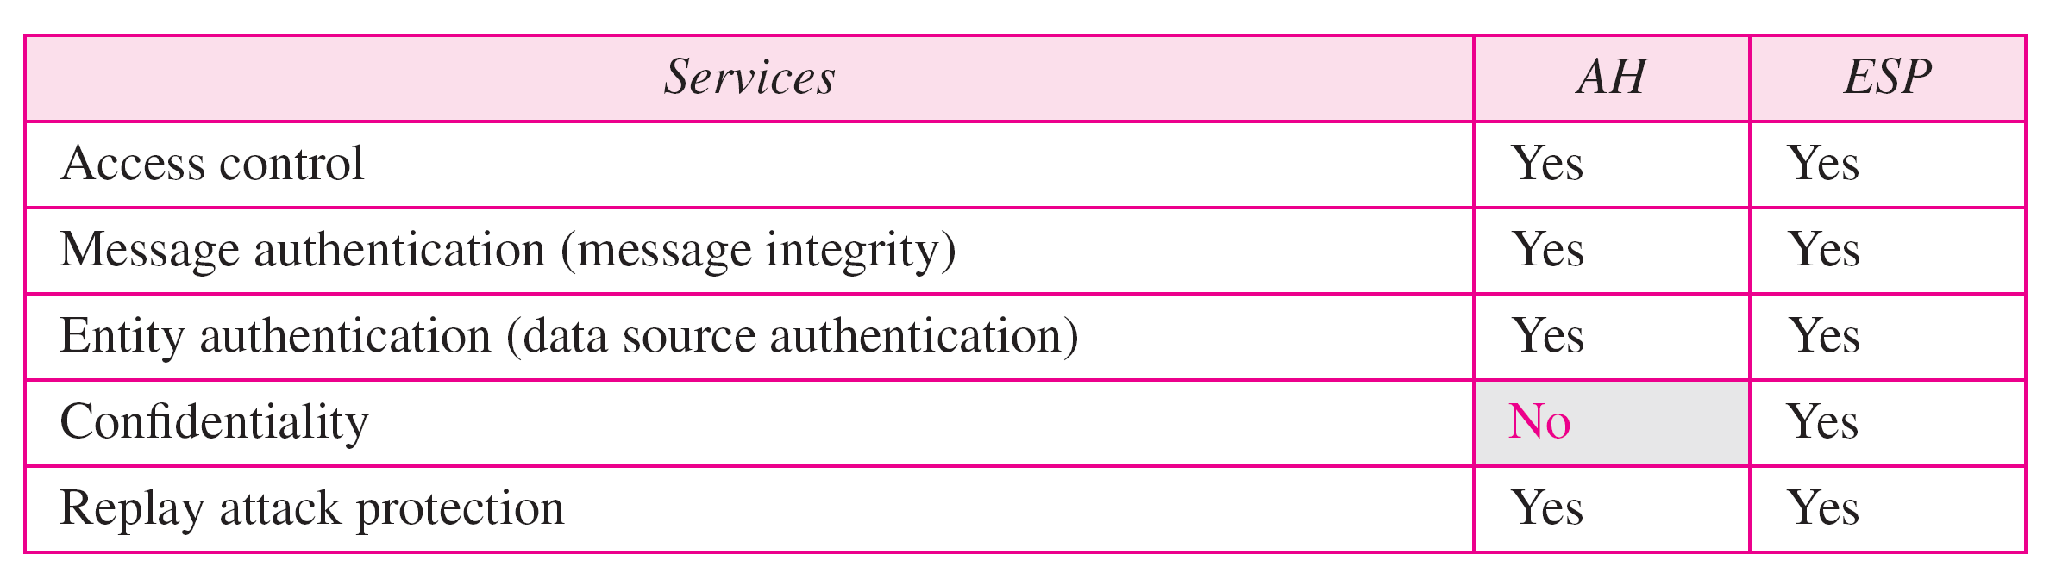
Services Provided by IPSec
The two protocols AH and ESP can provide several security services for packets at the network layer as shown in the table below:

Slide 22
Services Provided by IPSec
Access Control: IPSec provides access control indirectly by using a Security Association Database (SADB).
Message Authentication: the integrity of the message is preserved in both AH and ESP by using the authentication data.
Entity Authentication: The security association and the keyed-hashed digest of the data sent by the sender authenticate the sender in both AH and ESP.

Slide 23
Services Provided by IPSec
Confidentiality: The encryption of the message in ESP provides confidentiality. AH doesn’t provide confidentiality.
Replay Attack Protection: both protocols prevent replay attack by using sequence numbers.

Slide 24
Security Association
It is a mechanism that IPSec used to establish the security parameters.
IP is connectionless protocol ( each datagram is independent of others).

Slide 25
Security Association
A set of security parameters can be established between a sender and a particular receiver the first time they have communication.
It is called Security Association
Using Security Association , IPSec changes a connectionless protocol (IP) to a connection- oriented protocol.

Slide 26
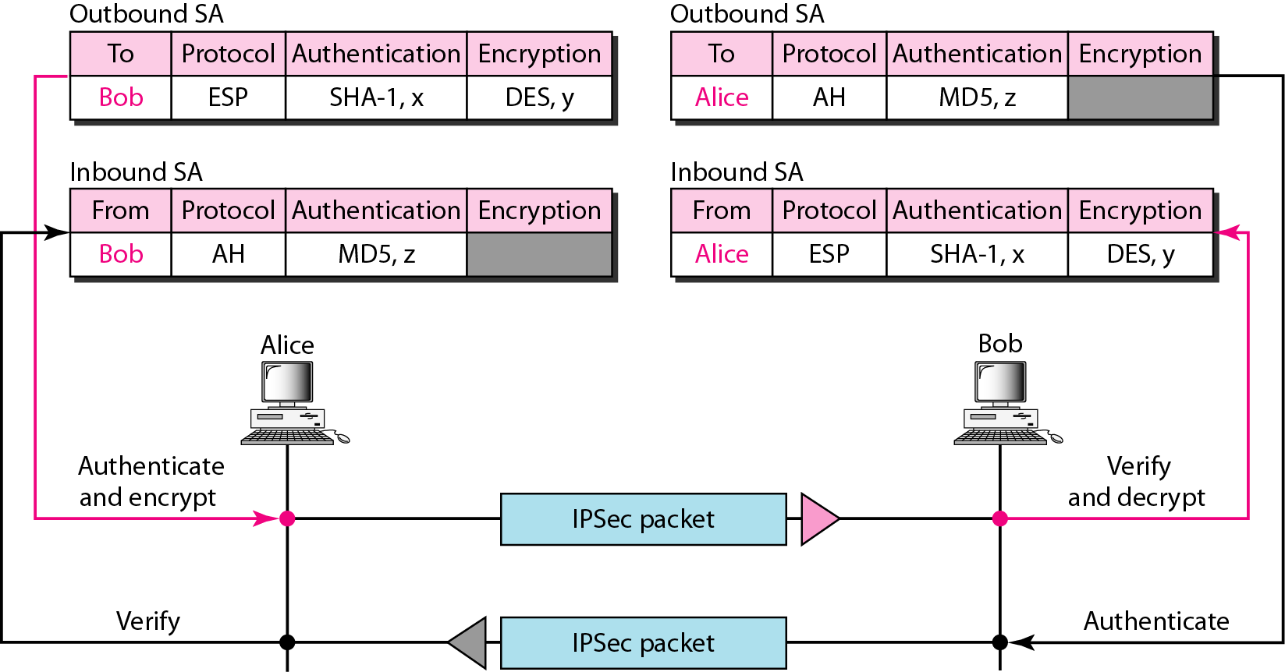
Simple inbound and outbound security associations

Slide 27
Security Association Database (SADB)
What if Alice needs to send to many people and receive from many people too.
She needs to have multiple inbound and outbound SAs.
Thus, SADB is needed to collect those se of SAs.
SADB it is a two-dimensional table with each row defining a single SA.
Normally, there are two SADBs one inbound and one outbound.

Slide 28
Security Parameter Index (SPI)
It is used to distinguish one association from the other.
Each association is defined by a parameter called the Security Parameter Index (SPI).
SPI contains the destination address ( outbound) or source address (inbound) and protocol (AH or ESP). ➔ uniquely identifies an association!

